Slide 1
Clustering

Slide 2
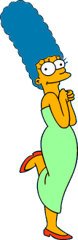









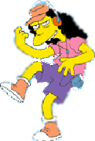
Two Types of Clustering
Slide based on one by Eamonn Keogh
Partitional algorithms: Construct various partitions and then evaluate them by some criterion
Hierarchical algorithms: Create a hierarchical decomposition of the set of objects using some criterion
Hierarchical
Partitional
Notes:
Have class break into groups and invent clustering algorithms.

Slide 3
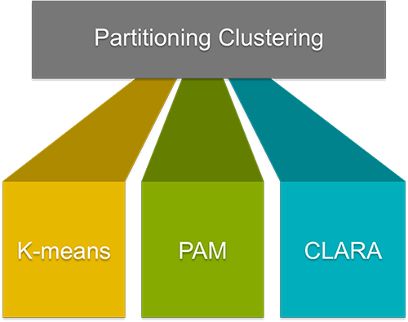

Slide 4
The most popular class of clustering algorithms that we have is the iterative relocation algorithms. These algorithms minimize a given clustering criterion by iteratively relocating data points between clusters until a (locally) optimal partition is attained. There are many algorithms that come under partitioning method some of the popular ones are K-Means, PAM(k-Medoid), CLARA algorithm (Clustering Large Applications) etc.

Slide 5


Slide based on one by Eamonn Keogh
We begin with a distance matrix which contains the distances between every pair of objects in our database.
0
8
8
7
7
0
2
4
4
D( , ) = 8
D( , ) = 1
0
3
3
0
1
0

Slide 6








Slide based on one by Eamonn Keogh
Partitional Clustering
Nonhierarchical, each instance is placed in exactly one of K non-overlapping clusters.
Since only one set of clusters is output, the user normally has to input the desired number of clusters K.

Slide 7
Demo
https://www.youtube.com/watch?v=nXY6PxAaOk0
https://www.youtube.com/watch?v=5I3Ei69I40s

Slide 8
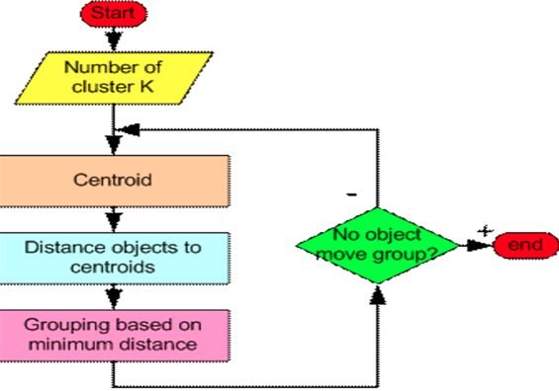
Partition Algorithm 1: k-means
1. Decide on a value for k.
2. Initialize the k cluster centers (randomly, if necessary).
3. Decide the class memberships of the N objects by assigning them to the nearest cluster center.
4. Re-estimate the k cluster centers, by assuming the memberships found above are correct.
5. If none of the N objects changed membership in the last iteration, exit. Otherwise goto 3.

Slide 9
K-means Clustering: Step 1
Algorithm: k-means, Distance Metric: Euclidean Distance
5
4
k₁
3
k₂
2
1
k₃
0
0
1
2
3
4
5
Slide based on one by Eamonn Keogh

Slide 10
K-means Clustering: Step 2
Algorithm: k-means, Distance Metric: Euclidean Distance
5
4
k₁
3
k₂
2
1
k₃
0
0
1
2
3
4
5
Slide based on one by Eamonn Keogh

Slide 11
K-means Clustering: Step 3
Algorithm: k-means, Distance Metric: Euclidean Distance
5
4
k₁
3
2
k₃
1
k₂
0
0
1
2
3
4
5
Slide based on one by Eamonn Keogh

Slide 12
K-means Clustering: Step 4
Algorithm: k-means, Distance Metric: Euclidean Distance
5
4
k₁
3
2
k₃
1
k₂
0
0
1
2
3
4
5
Slide based on one by Eamonn Keogh

Slide 13
K-means Clustering: Step 5
Algorithm: k-means, Distance Metric: Euclidean Distance
k₁
k₂
k₃
Slide based on one by Eamonn Keogh

Slide 14
Comments on k-Means
Strengths
Relatively efficient: O(tkn), where n is # objects, k is # clusters, and t is # iterations. Normally, k, t << n.
Often terminates at a local optimum.
Weakness
Applicable only when mean is defined, then what about categorical data?
Need to specify k, the number of clusters, in advance
Unable to handle noisy data and outliers
Not suitable to discover clusters with non-convex shapes
Slide based on one by Eamonn Keogh

Slide 15
Bottom Line
K-means
Easy to use
Need to know K
May need to scale data
Good initial method
Local optima
No guarantee of optimal solution
Repeat with different starting values

Slide 16
Numerical ?

Slide 17
Other Clustering in R
Hierarchical Clustering (agglomerative)
Create a distance matrix using ‘dist()’
Create the hierarchy using ‘hclust()’
Model Based Clustering
Use ‘mclust()’ to create the clusters on the basis of
Bayesian Information Criterion (BIC)
Parameterized Gaussian mixture models

